Slide 1
Determinants (I)
MATH 4341 : Linear Algebra
Aashnan Rahman
Junior Lecturer
Department of Computer Science and Engineering (CSE)
Islamic University of Technology

Slide 2
Determinants
Tool to measure exactly how much things are stretched out or squeezed in.
5 0
0 3
A =
det (A) = 15

Slide 3
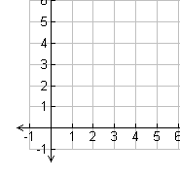
Determinants
5 0
0 3
1 1
5 0
0 3
5 3
=
1
+
1
=

Slide 4
Determinants
5 0
0 3
det ( ) = 15
area = 1
area* = 15
area* = 15 area

Slide 5
Determinants
The very special factor by which linear transformation changes any region is the determinant.
Square Matrix represented by a single number.

Slide 6
Determinants (cases)
Scaling
|det(A)| > 1
2. |det(A)| < 1
3. |det(A)| = 1
Stretched
Squeezed
Same

Slide 7
Determinants (cases)
Orientation
det(A) > 0
2. det(A) < 0
3. det(A) = 0
Same direction
Reversed
Deformed

Slide 8
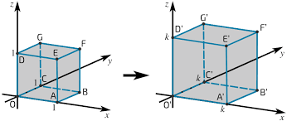
Determinants (cases)
Shapes
2D
2. 3D
Area
Volume

Slide 9
References
Gilbert Strang (L18)

Slide 10

¡THANKS!

